Slide 1

Expelliarmus Bot We remove the hassle of expenses
Lightning Talk

Slide 2
Goal:
Next Phase:
To create a simplified process for handling expenses.
Getting list of submitted/saved expenses
To take an action on the submitted expenses(Approve/Reject)
Notifications to Managers when expense is submitted
Document crawler in Gdrive
Category Prediction
Receipt Upload
Value:
Expense process optimization
User friendly interaction
Avoid late fees

Slide 3
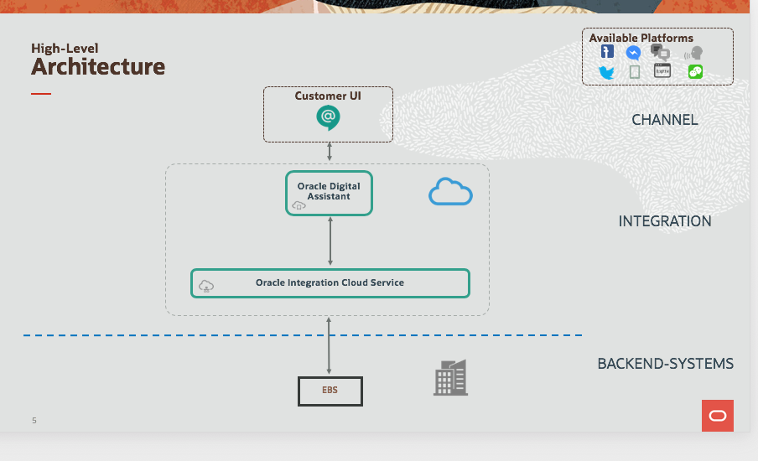

Slide 4
Demonstration

Slide 5

Thank you
Vertika Upadhyay
Mehul Jethva
Sai Hemchandra

